Slide 1

Basics of Neural Network Programming
Gradient Descent
deeplearning.ai

Slide 2
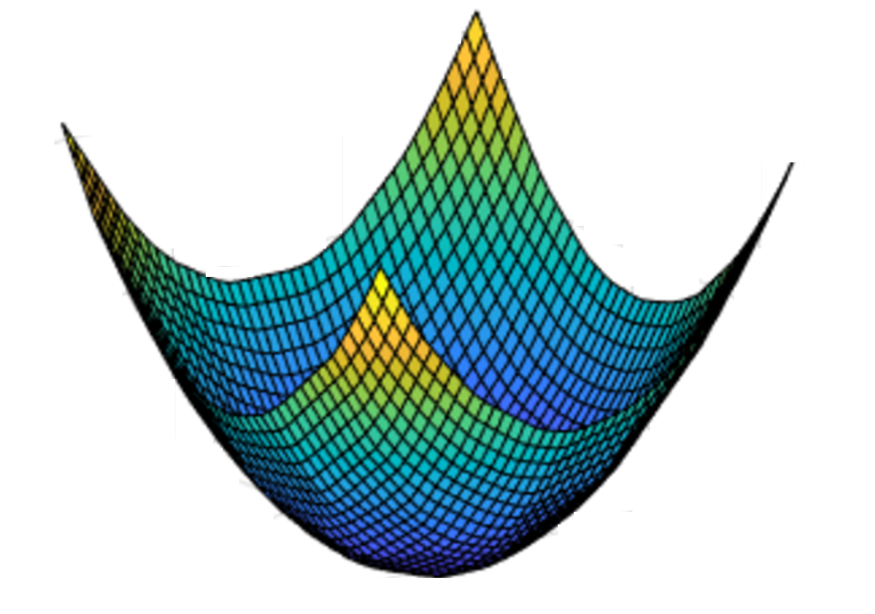
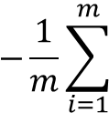


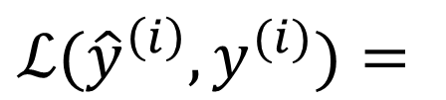

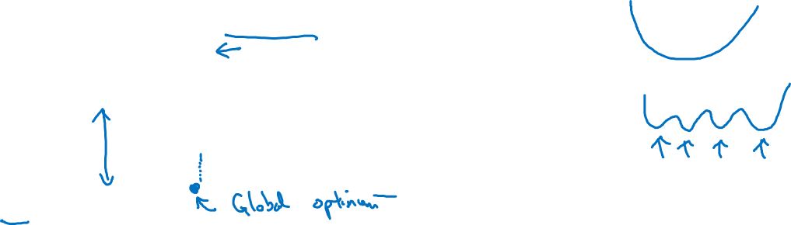
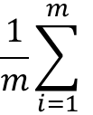



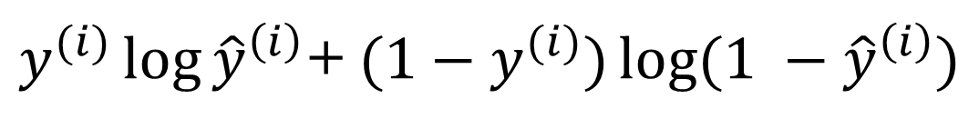

Gradient Descent
Recap: $\hat{y}= σ\left(w^{T}x+b\right)$, $σ\left(z\right)=\frac{1}{1+e^{−z}}$
$$\frac{1}{m}\sum_{i=1}^{m}{ }$$
$ℒ({\hat{y}}^{\left(i\right)},y^{(i)})$ $=$
$$−\frac{1}{m}\sum_{i=1}^{m}{ }$$
$$J\left(w,b\right)=$$
$y^{(i)}\log{{\hat{y}}^{\left(i\right)}}$+ $({1−y}^{(i)})\log{(1 −{\hat{y}}^{\left(i\right)})}$
Want to find $w,b$ that minimize $J\left(w,b\right)$
$$J\left(w,b\right)$$
$$b$$
$$w$$

Slide 3

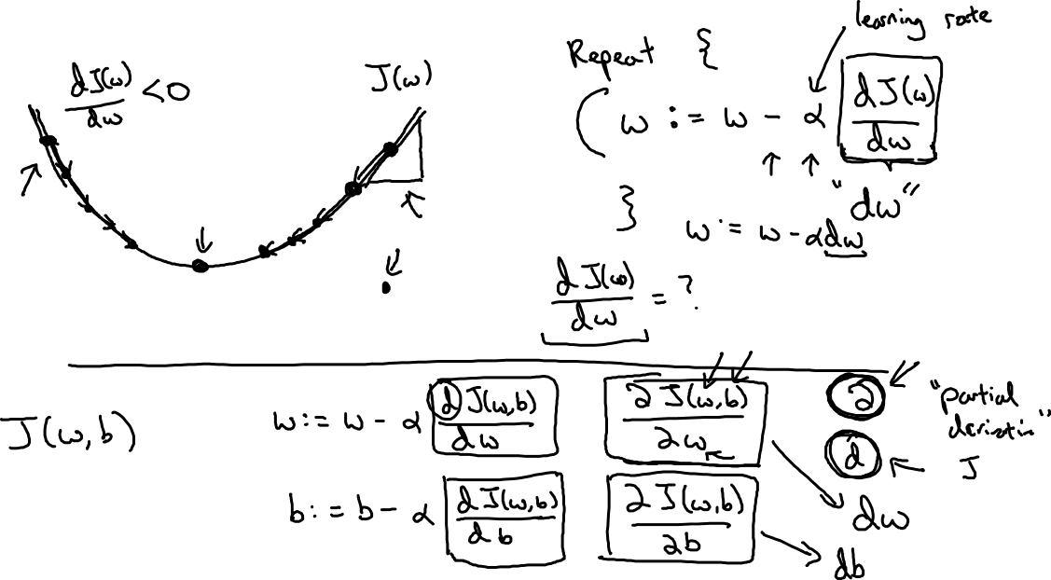
Gradient Descent
$$w$$

